Slide 1



How secure are primary health care facilities to provide services for the vulnerable population?: Experience of providers in a maternal and Child Health programme
Enyi Etiaba; B. Uzochukwu; B. Ebenso; U. Agbawodikeizu; A. Manzano;
U. Ogu; R.Huss; O.Onwujekwe; N. Ezumah; J. Hicks; J. Newell; T.Ensor, T. Mirzoev.
5th AfHEA Bienniel Conference, Ghana 11-14 march 2019

Slide 2
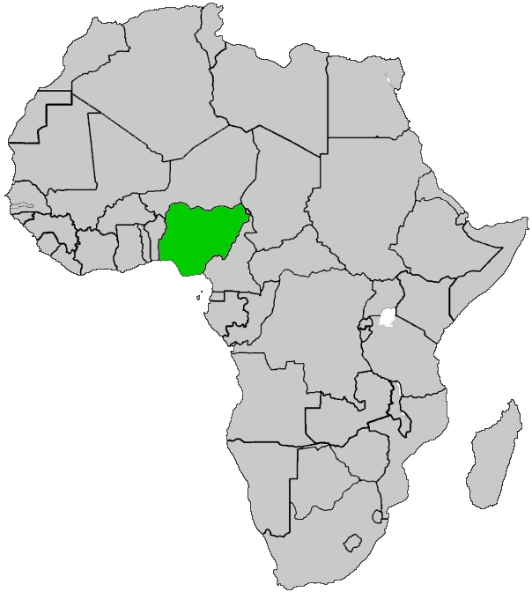
NIGERIA
A low middle income country in sub-Saharan Africa
Estimated population of 180 million
Has 36 states and a federal capital territory
Poor maternal and child health (MCH) indices
Did not meet MDGs 4 & 5

Slide 3
SURE-P—SUbsidy Reinvestment and Empowerment Programme
Demand and Supply-side interventions to improve Maternal and Child Health (MCH).
October 2012 to April 2015
A national programme but this evaluation carried out in one of the 36 states (Anambra state)

Slide 4
PROGRAMME COMPONENTS
Supply
Demand
Deployment of trained midwives
Village Health Workers (VHWs)
Activation of Ward Development Committees (WDCs)
Infrastructure Upgrade
Medicines and Consumables
Conditional Cash transfer (CCT) as incentive to utilize services

Slide 5
PROGRAMME STRUCTURE
WDC
Client
Midwives
Client
Midwives
PHC
PHC
CHEWs
VHWs
CHEWs
VHWs
referral
  HWs deployed to reach deeper into target communities with help of WDCs
PHC
Hospital
PHC
referral
Client
Midwives
Midwives
Client
WDC
CHEWs
VHWs
CHEWs
VHWs
SOURCE: MCH PIU

Slide 6


PROGRAMME STRUCTURE
Facilities- HWs, managers
Community-
WDCs, Users/families
VHWs
Improved MCH

Slide 7
METHODS
June 2015 to May 2020
Study sites -2 SURE-P clusters and 1 non SURE-P cluster as a Control
In-depth interviews, Focus Group Discussions (FGDs) with HWs, VHWs, WDCs and Service users
Observations at facilities
Survey
HMIS data analysis

Slide 8
PROGRAMME THEORIES
Supply……If health workers are deployed to health facilities that have security men, comfortable accommodation within the facilities, (C), they will feel safe and confident to provide round the clock services (M) which will likely lead to improved MCH services, and outcomes (O).
Demand…If WDCs are mobilized to provide security for the facilities, pregnant women provided CCT and encouraged by VHWs to attend facilities (C ) , pregnant women will feel safer and confident to attend health facilities (M), leading to increased utilization of facility-based MCH services

Slide 9
EXPERIENCES DIFFERED
Night time security was a recurring issue across all study facilities for providers who were all female
Experiences differed depending on whether action was taken or not to provide human security (security guards)
Actions usually taken by the community and not by SURE-P

Slide 10
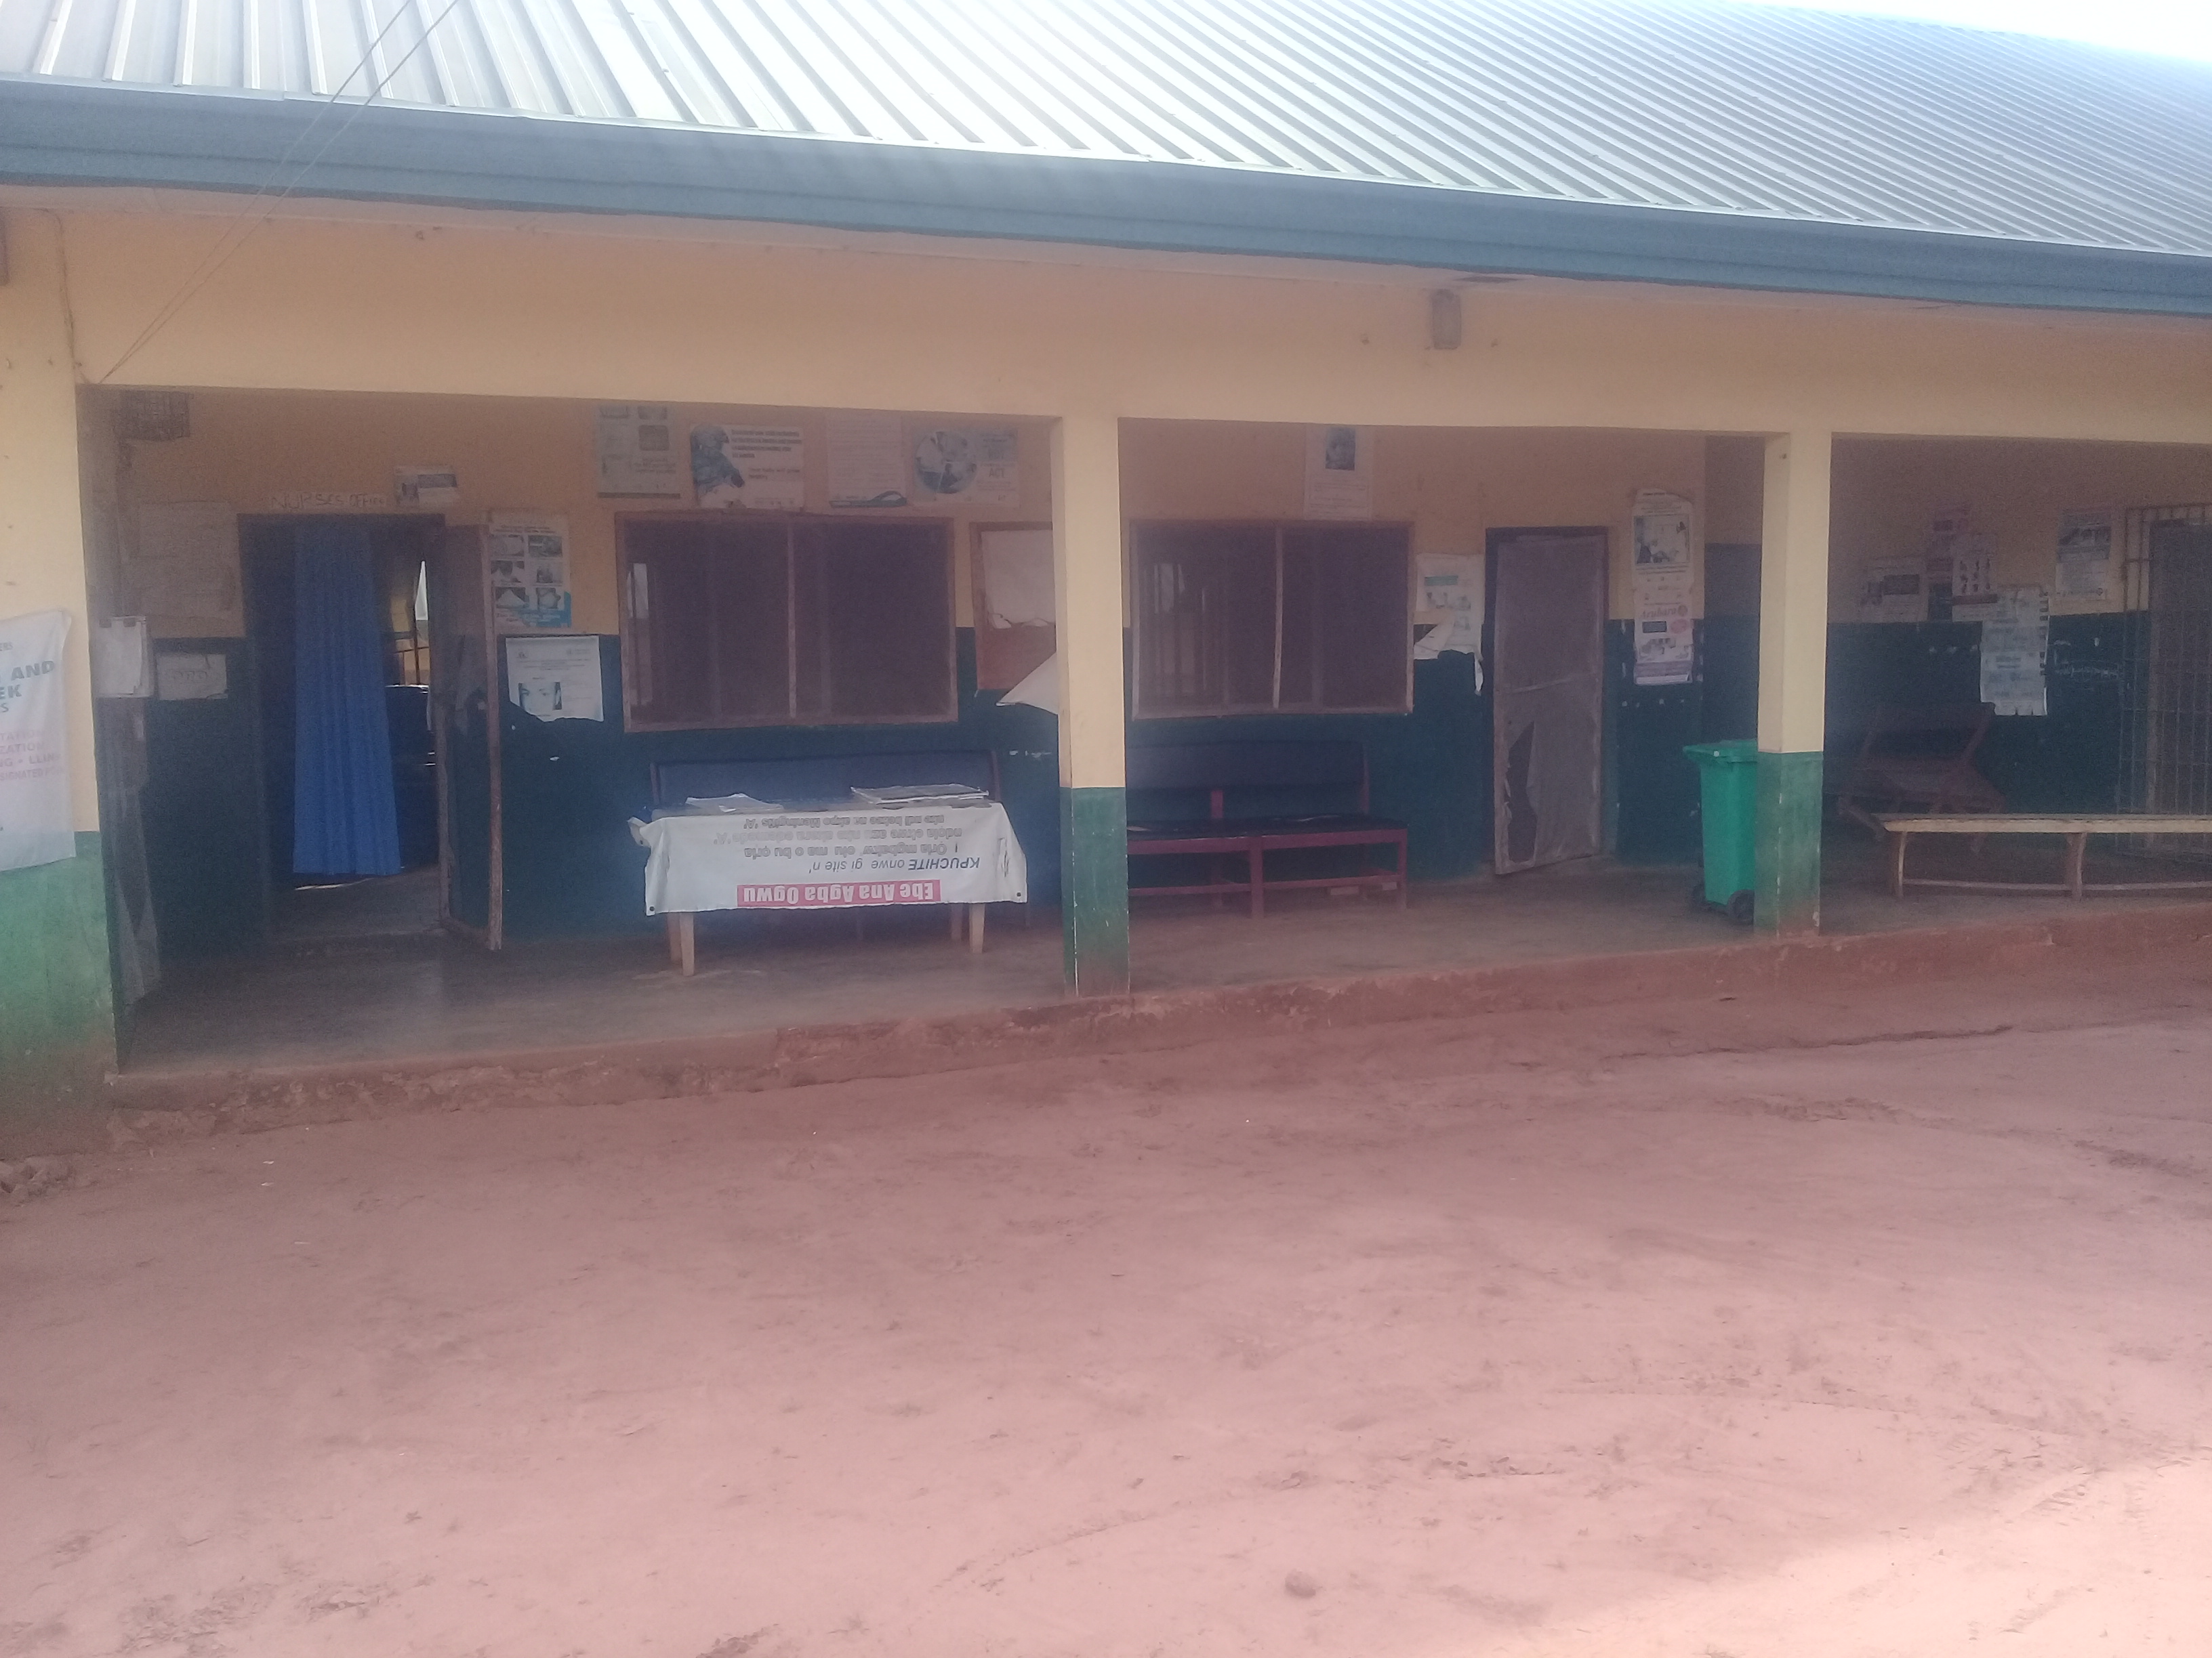
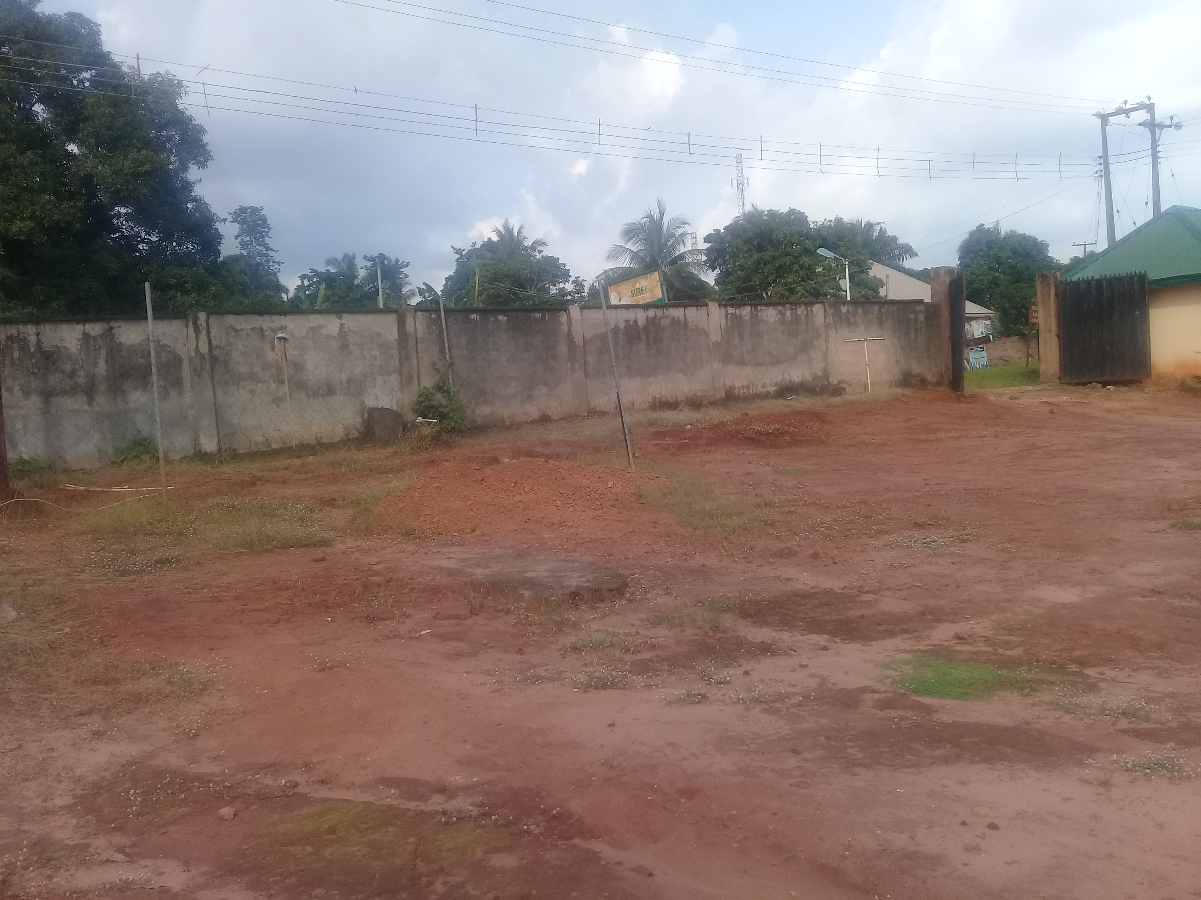
POSITIVE EXPERIENCES..
“When the Igwe (traditional ruler) came to visit us, I told him that we didn't have security, I told him that some rogues jumped into the compound in the night, after that incident, I said that I will not continue.. that it is better for them to assign a security man to the facility to be there. So, …he recruited two security men and he was the one paying them, ….he was the one paying them. And we were so happy and relaxed.” (Facility OIC)

Slide 11
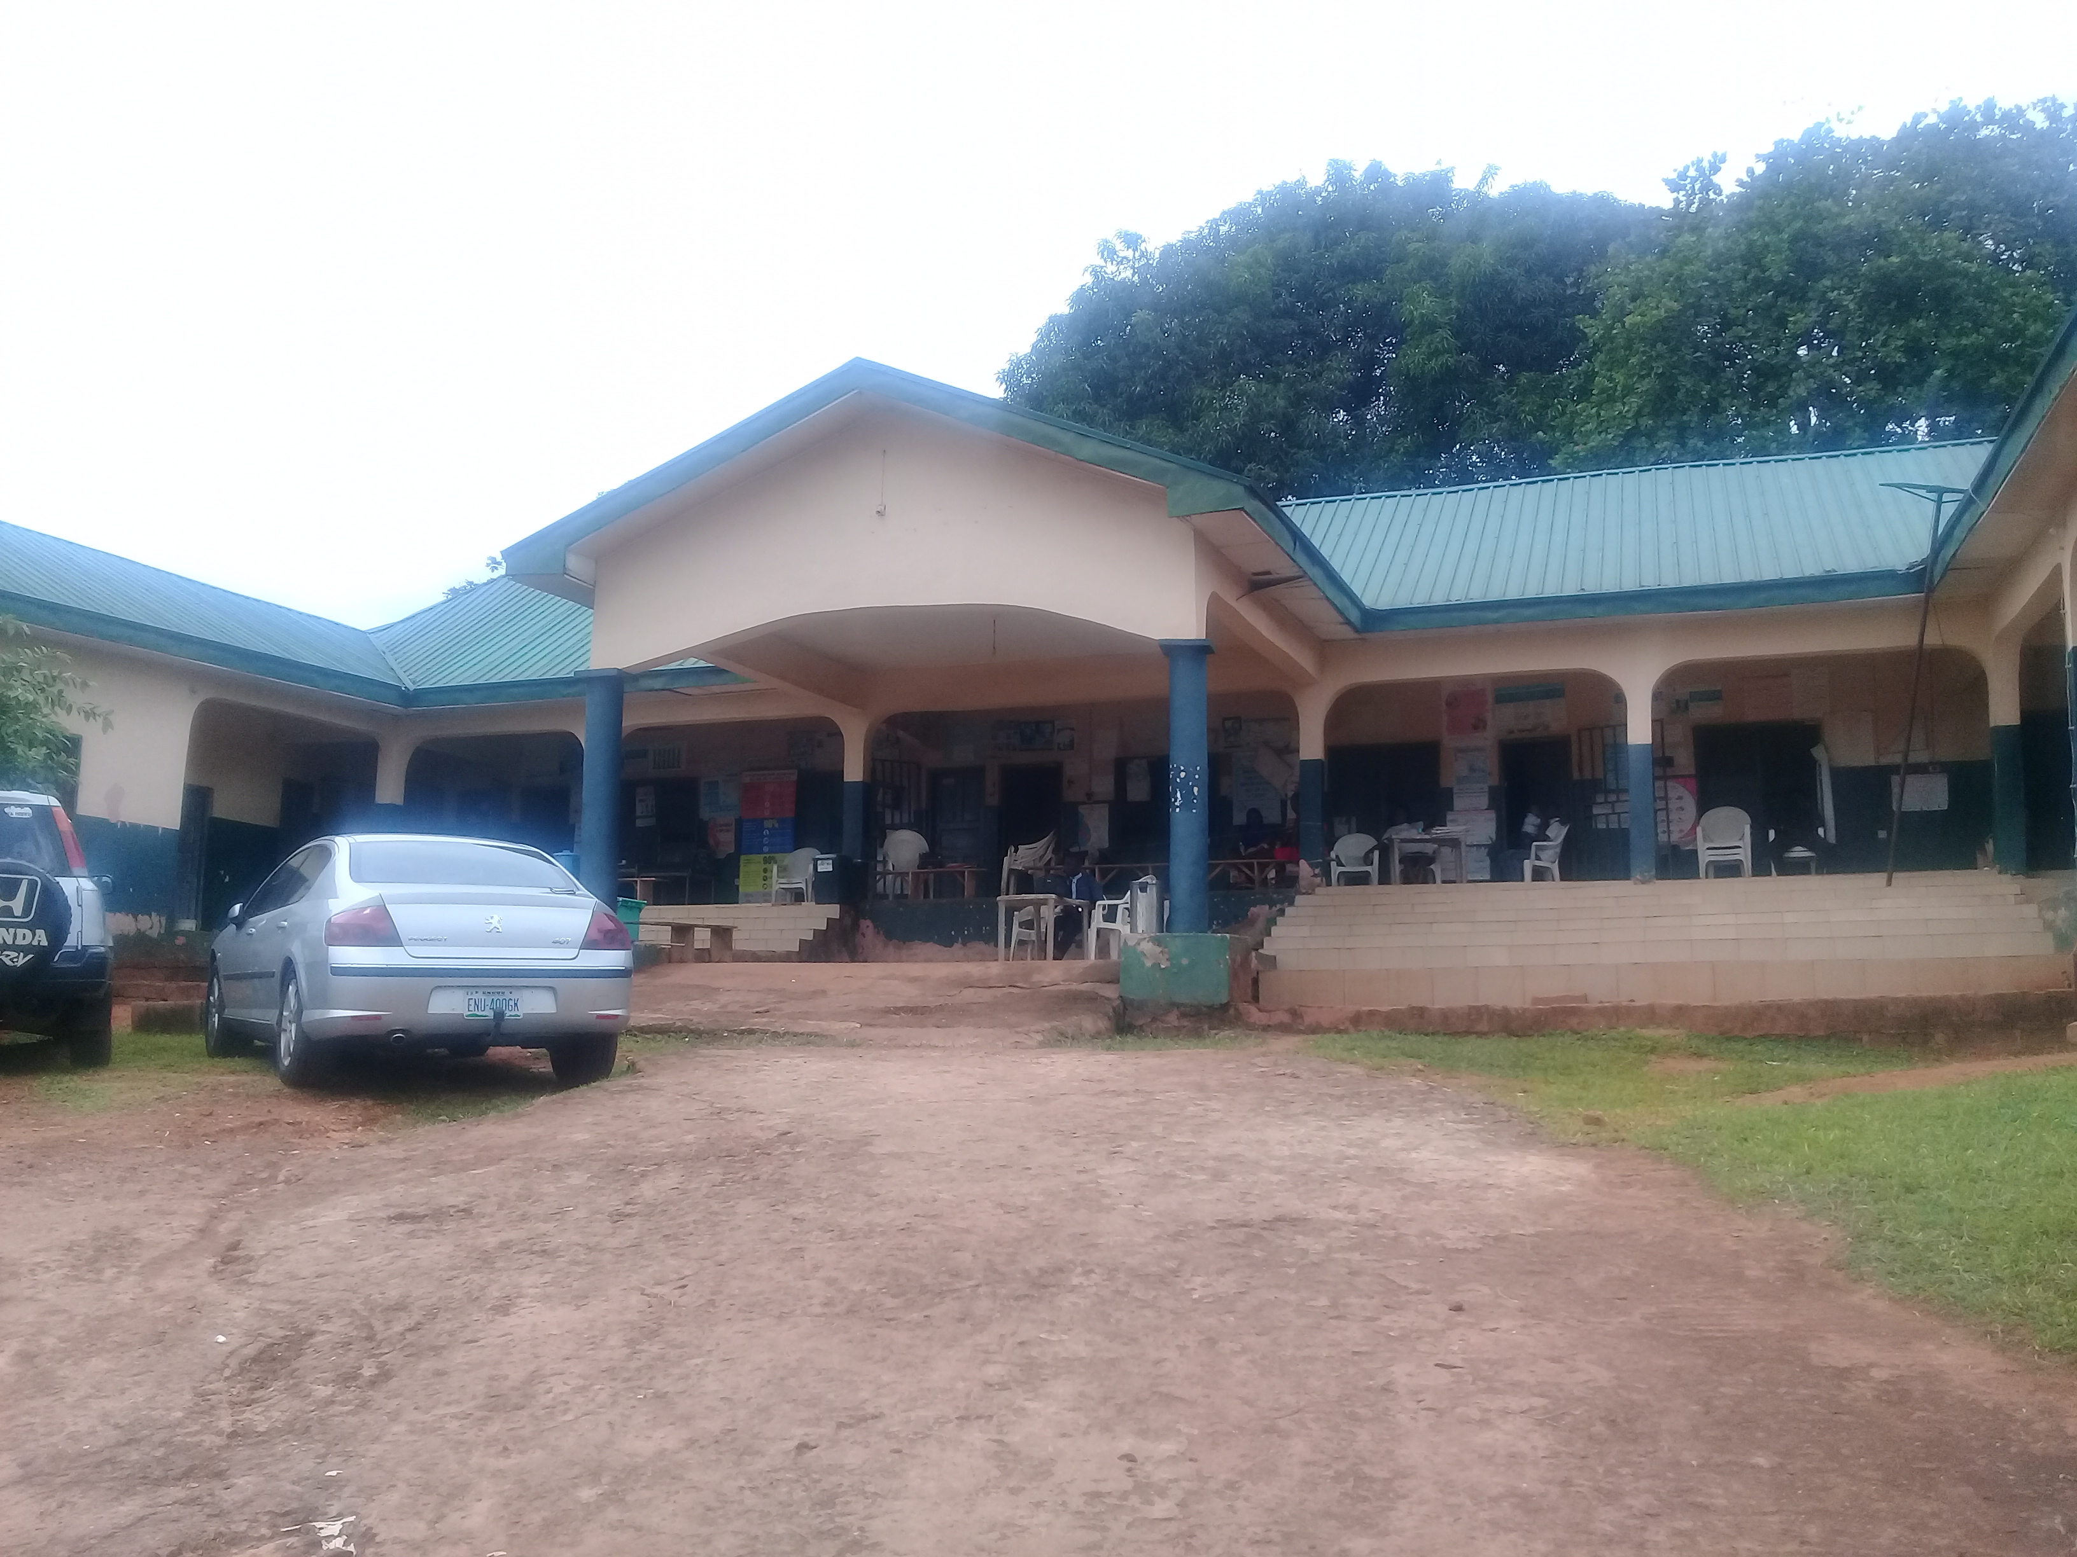
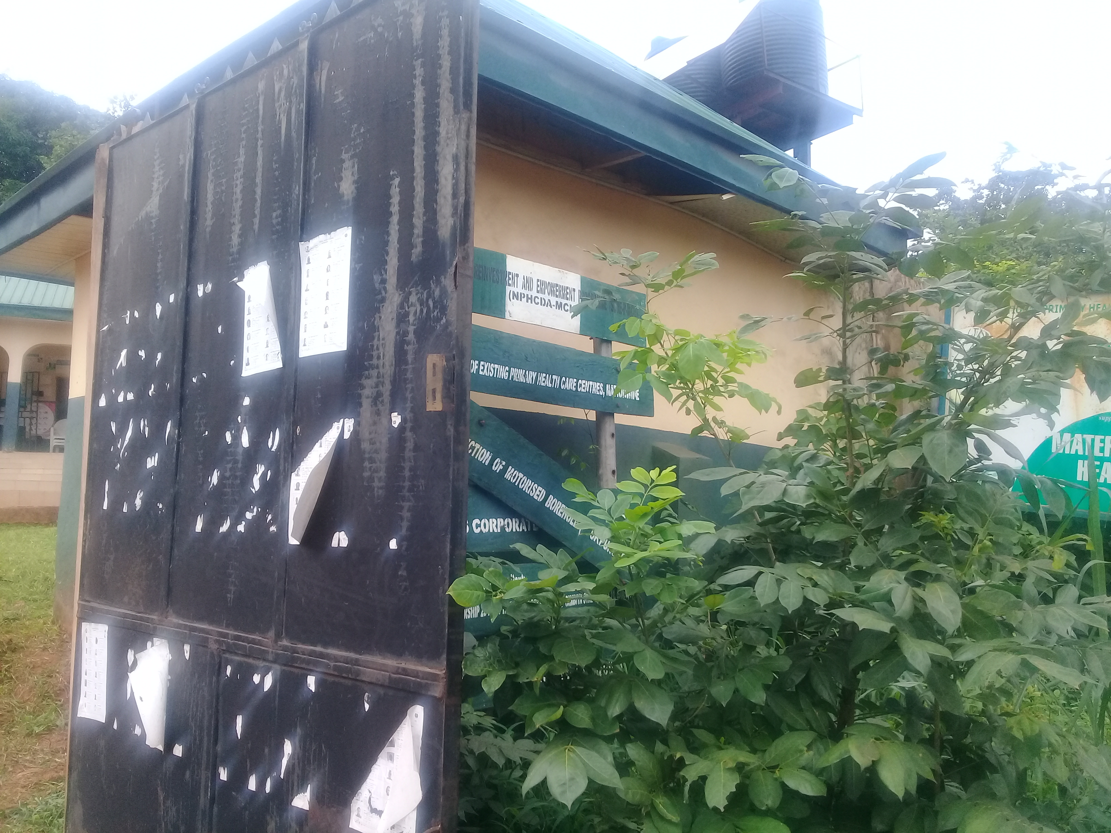
POSITIVE EXPERIENCES..
“When I came in, there was no security, and I knew I will be sleeping here. I am a woman. So I went, and I told them (WDC), give me security, and with that I can make this place what you want it to be. They gave me, and I said, only night watch, that’s what I need, and they gave me one. And since then, we’ve been sleeping here; and when some of them come, they will relax. Because you know most women also are too afraid.” (OIC CIF2)

Slide 12


“We and the community supported them by first making sure that there is a security guard here. The security guard is paid by the community to help secure the drugs that were brought here then. The community also assisted in bringing some women to assist the health workers. I don’t have much to say on this but I know that the village health workers do encourage them to come and they are coming. Moreover, the fence, gate and security also encouraged them to come because they are sure of security anytime” (WDCs, C1F2).

Slide 13
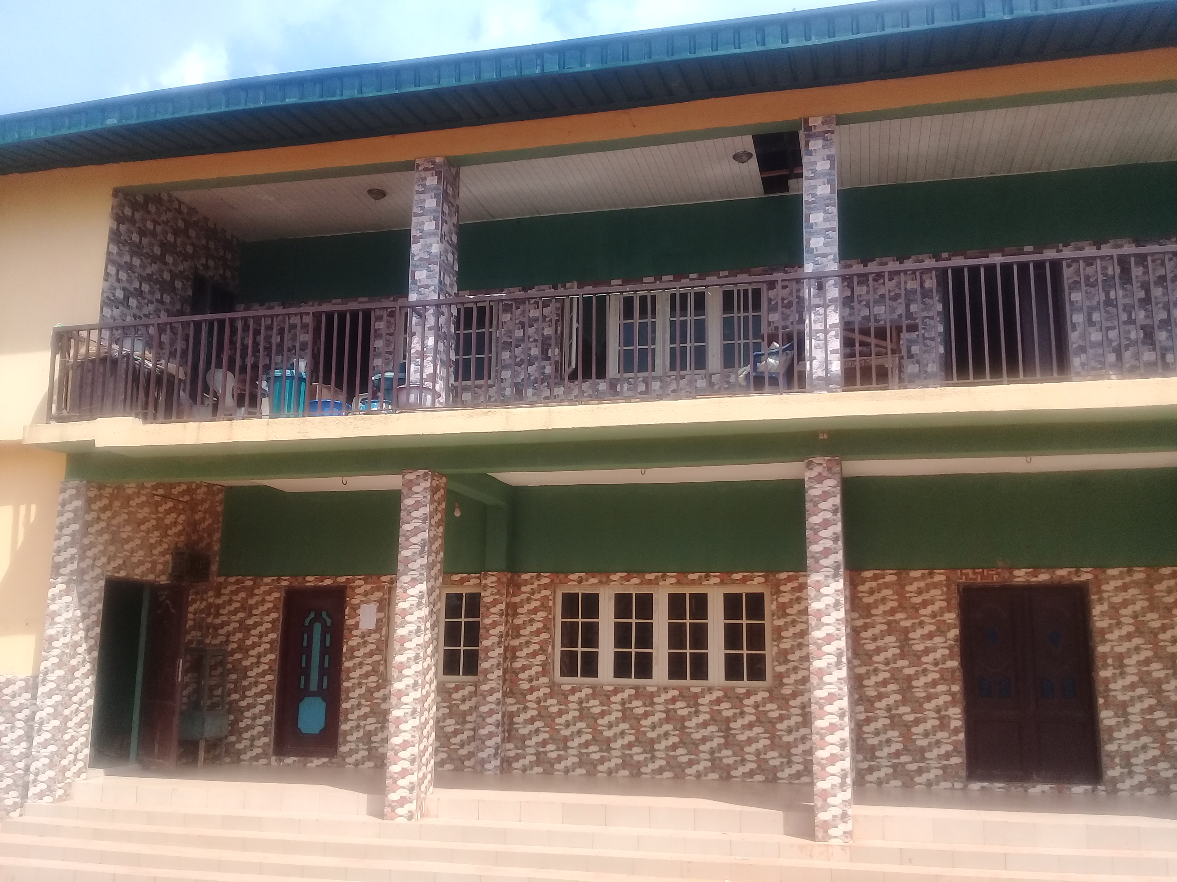
NOT SO POSITIVE…..
“No security, we don’t have any security, we don’t have a fence. Look at the house not fenced, the building not fenced so it is a challenge.”
“We work alone, one person in a shift and in the night a staff working alone here, how can she sleep in this whole hall alone? At times staying there I may not sleep, I will be awake all night because of fear, no fence, no security, no partner, that is our challenge” (Facility OIC)

Slide 14
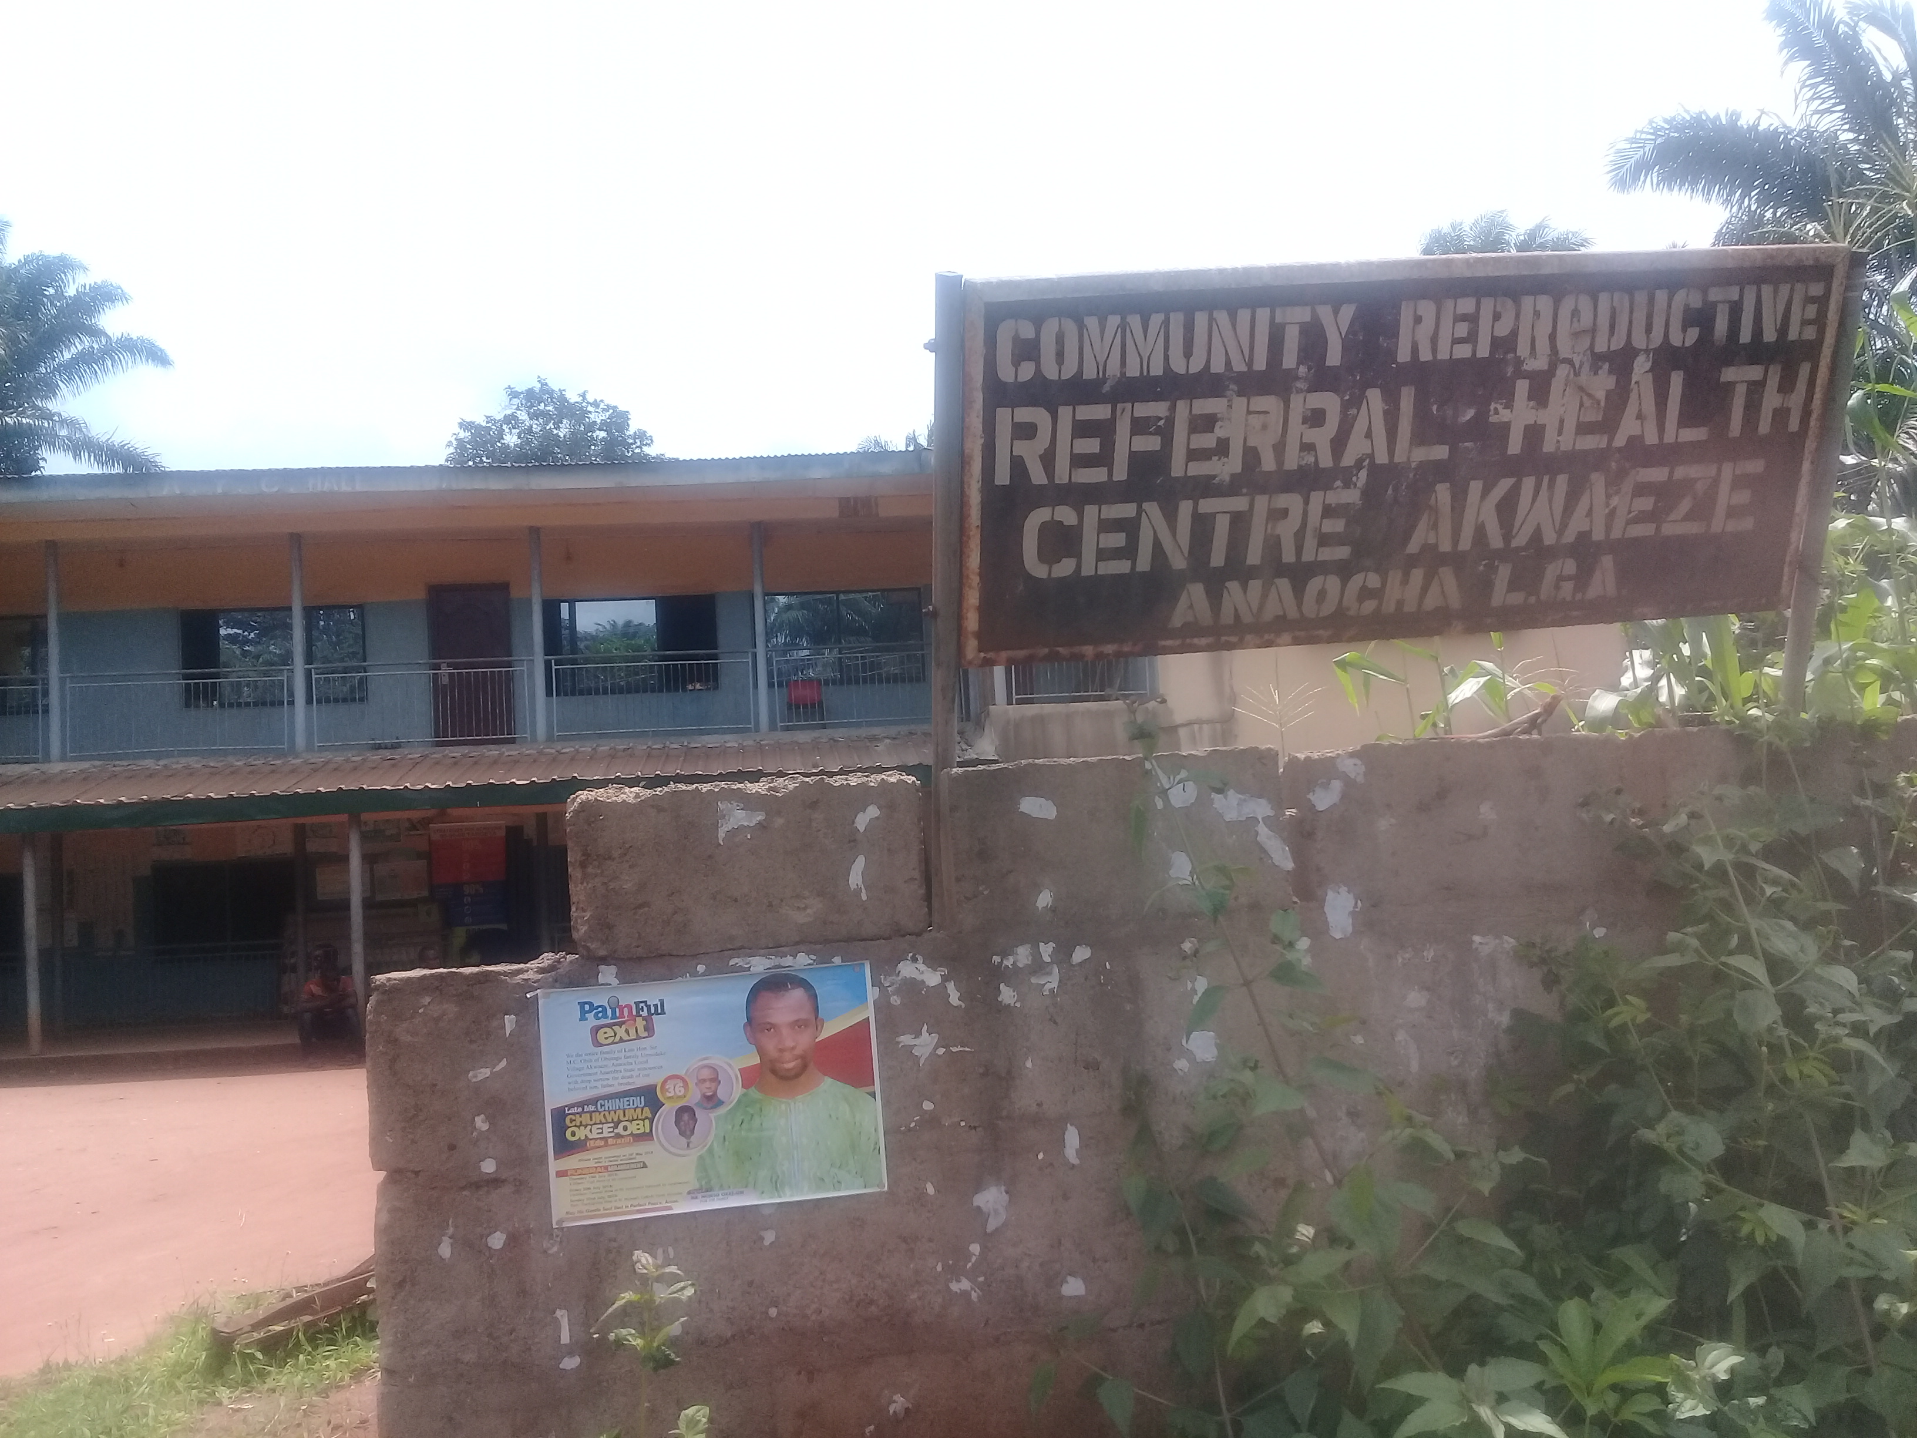
NOT SO POSITIVE…..
“But as for the security aspect (sighs) this place is not secured because no gate. The gate that was here was removed immediately I entered here……And then we complained and complained, the gate was not put back. The security is zero……all of us were complaining about the lack of security…First is to provide conducive environment … secure the environment.”
(HW- SURE-P Midwife)

Slide 15
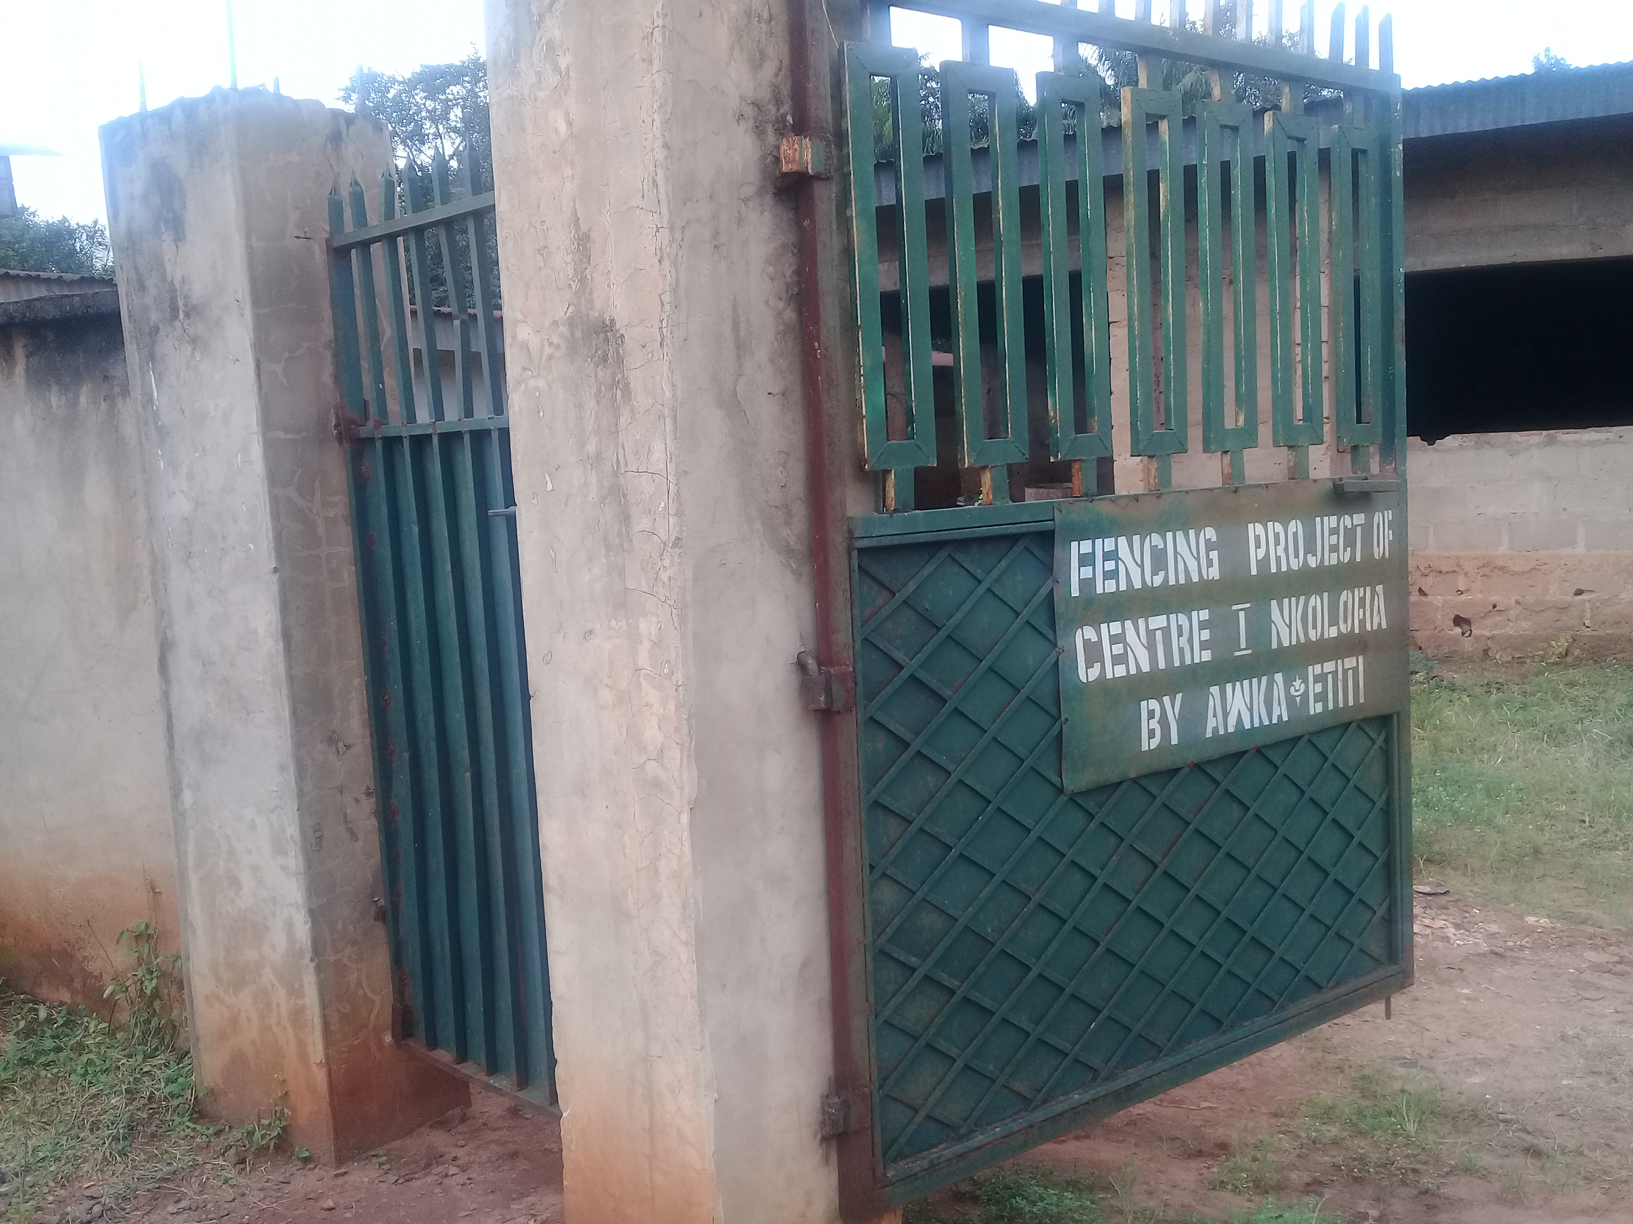
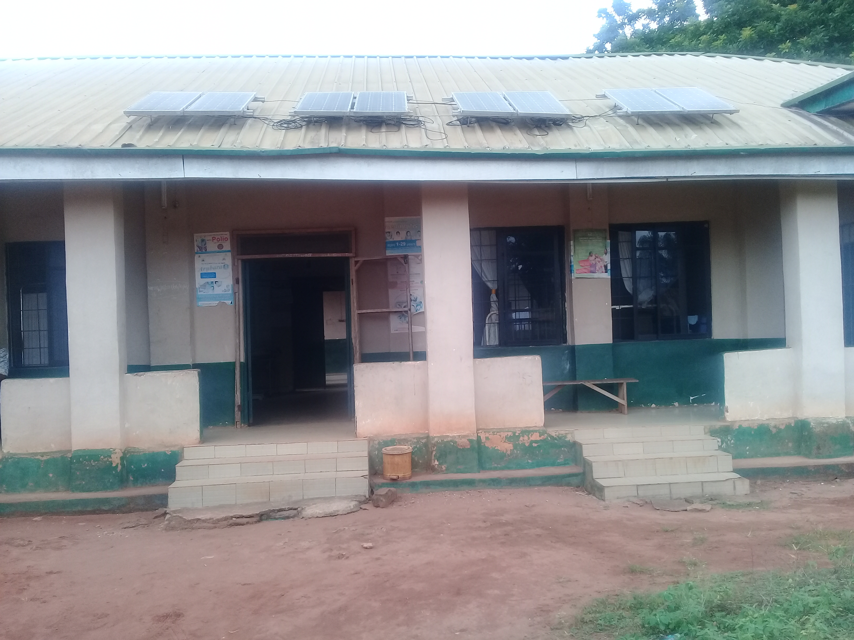
NOT SO POSITIVE…..
“Then the security issue is the most important because most pregnant women come in at night to deliver, and it is risky especially with this our large uncompleted building, crossing over to open the gate. So, in most cases, we have to get somebody to stay there and liaise with the person on the conditions.” (OIC –C2F2)

Slide 16
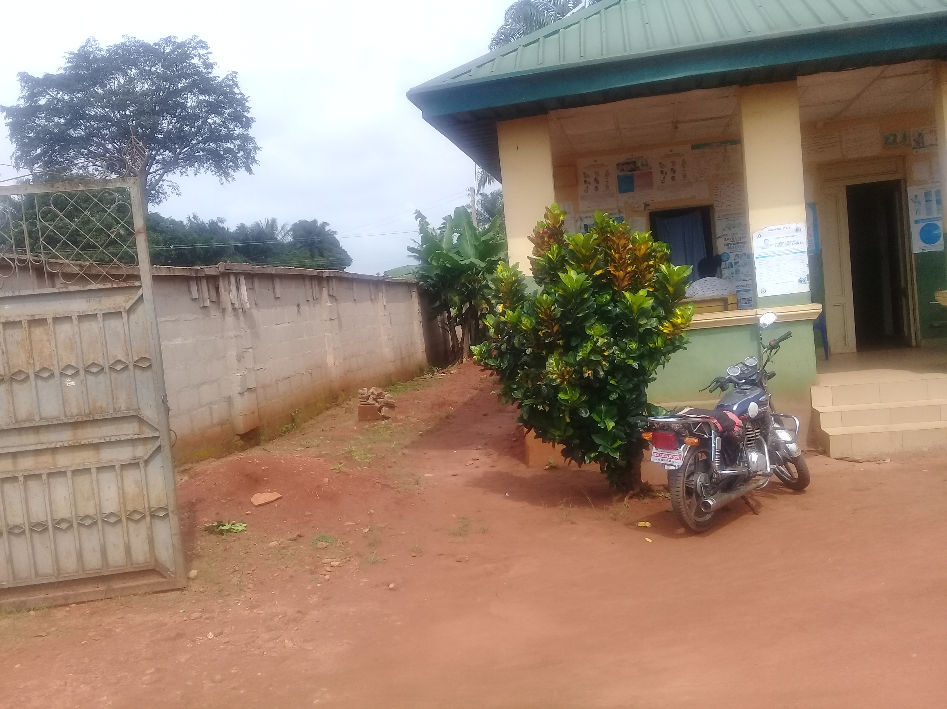
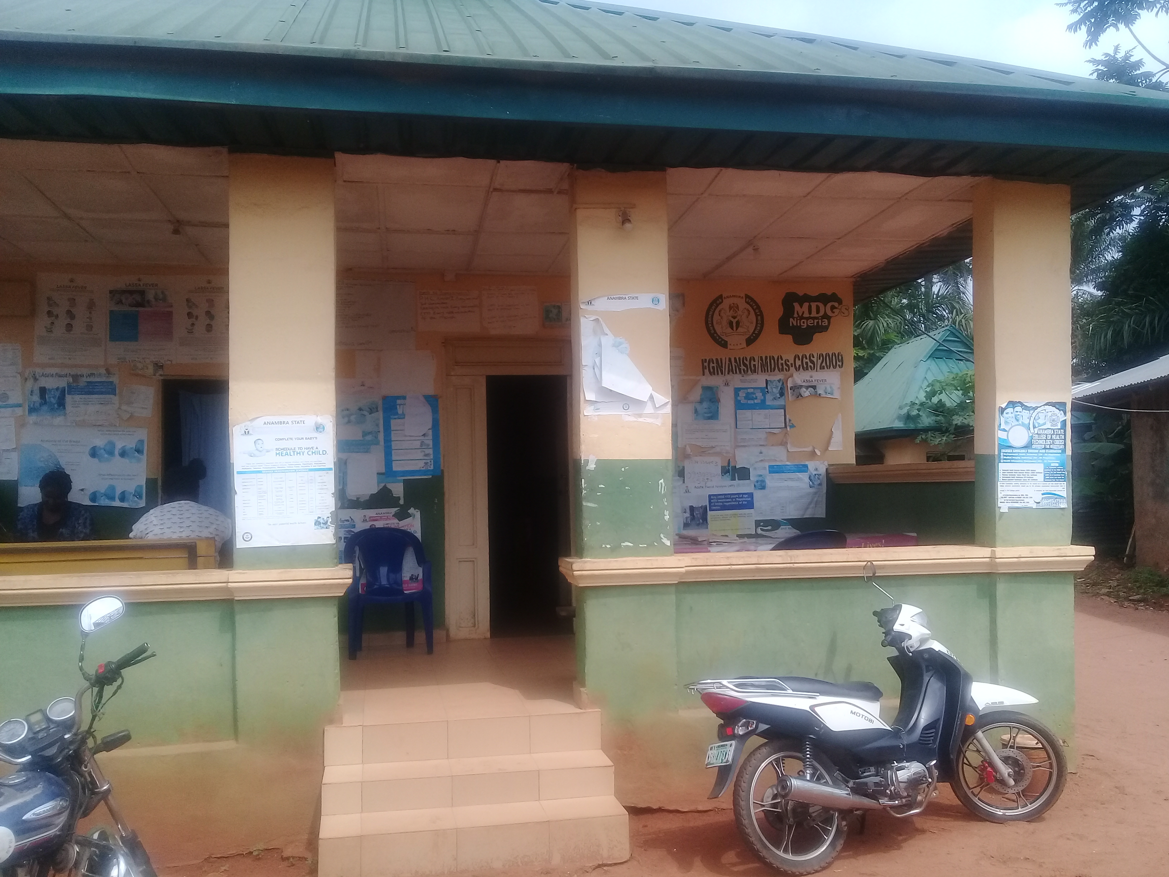
CONTROL CLUSTER
“Security has never been in this facility……... You know all the staff here are females, we shouldn’t be seen or stay outside at such odd hours unaccompanied by a male.” (OIC)
“…….But since the community promised to extend their security watch to the area of the facility, we started working night shifts. Things then started working well. When the people noticed we now worked night shifts, if they have any medical emergency at night, they rushed to the facility.” (OIC)

Slide 17
KEY MESSAGES
Facility security (or lack of it) was a critical influence on provision and use of services , especially at night
Has the potential to negatively impact an otherwise well funded programme
Facility security should be made a key consideration in planning further maternal and child health programmes.

