Slide 1
Assessing the Effect of Performance-Based Financing (PBF) on Health Care Quality in Nigeria: Experiences from Nigeria State Health Investment Project (NSHIP) Implementing States
Presentation at AfHEA 5th Scientific Conference
11 – 14 March 2019
Kempinski Hotel, Gold Coast City
Accra, Ghana
Michael C. Ajuluchuku
Muhammad Mashin
Binta Ismail
Ismail N. Salihu
Ndidi F. Ijeh
Chidinma Paul-Iyaji
Oritseweyimi Ogbe
Oladimeji I. Olayinka

Slide 2
Presentation Outline
Nigeria’s Selected Health Indices
Introduction
Approach to Quality of Care Under NSHIP
Quality of Care Assessment in NSHIP
Paying for Quality in NSHIP
Material and Methods
Results
Challenges
Conclusion
Recommendations

Slide 3
NIGERIA’S SELECTED HEALTH INDICES
Indicator | 2003 | 2008 | 2013 | 2015 MDG target
Infant mortality rate (per 1,000 live births) | 100 | 75 | 69 | 30
Under-5 mortality rate (per 1,000 live births) | 201 | 157 | 128 | 60
Maternal mortality ratio (per 100,000 live births) | 800 | 545 | 576 | 260
Births attended by skilled health personnel | 36% | 42% | 38.1% | 100%
Health indices in Nigeria have missed the 2015 MDG targets
Especially MNCH indicators

Slide 4
Introduction
Health systems are measured by the population health indices as well as quality of care provided
According to WHO measurement approach
Between 2000 and 2010, the Nigerian health system occupied third to the worst performed health systems in the World
MNCH targets missed under the MDGs
Systemic issues
high fragmentation/poor coordination, low incentives, low technical efficiency, chronic stock-outs of essential drugs, dilapidated infrastructure/equipment and lack of systematic measure of health care quality and system performance
Initiation of interventions to address poor health indices in Nigeria to pave way for SDGs/UHC attainment
Nigeria State Health Investment Project (NSHIP) with focus on Performance-Based Financing (PBF)

Slide 5
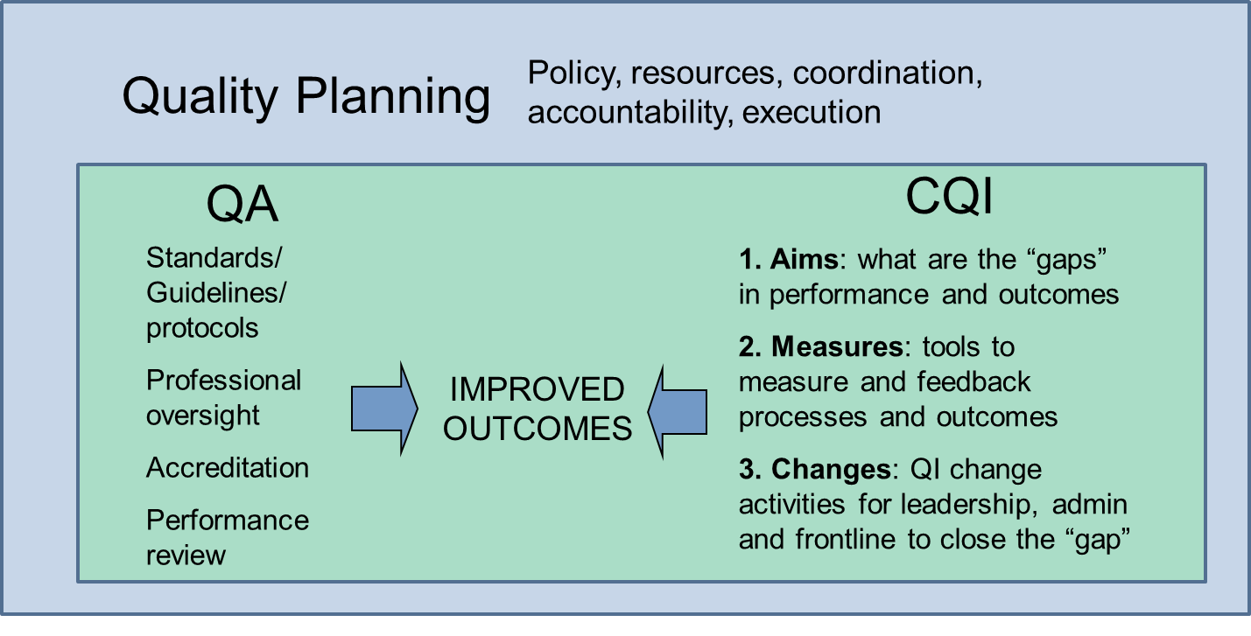
Approach to Quality of Care Under NSHIP
Model | Quality Definition or Components
US Institute of Medicine | “The extent to which health services provided to individuals and patient populations improve desired health outcomes”
Dlugacz, Restifo, and Greenwood | “Care that is measurably safe, of the highest standard, evidence-based, uniformly delivered, with the appropriate utilization of resources and services”
Donabedian Model | Evaluates care looking at structure, process, and outcomes
Juran Trilogy | Quality Planning, Quality Assurance, and Quality Improvement

Slide 6
Quality of Care Assessment in NSHIP
Uses a Weighted Quality Checklist (WQC) based on the Donabedian model.
Performance payments are linked to quality scores under PBF arm of NSHIP
The WQC is responsive to persistent challenges in QoC through alterations of weighting on structure and process of care indices
The LGHA and HMB measure quality at least once in each health facilities every quarter
The LGHA and HMB have contracts with the SPHCDA to carry out this assessment
LGHA & HMB are incentivized for this. This separation of functions ensures transparency.
The quality score is counter-verified by an independent body. Fraud will lead to sanctions

Slide 7
Weighting for health care quality domains – PHC domain
No | MPA Service | Points | Weight % | Structure | Process
1 | General Management | 21 | 6.5 | 100%
2 | Business Plan | 9 | 2.8 | 100%
3 | Finance | 15 | 4.6 | 100%
4 | Indigent Committee | 2 | 0.6 | 100%
5 | Hygiene | 31 | 9.6 | 100%
6 | OPD | 97 | 29.9 | 22.60% | 77.30%
7 | Family Planning | 22 | 6.8 | 86.40% | 13.60%
8 | Laboratory | 17 | 5.2 | 100%
9 | Inpatient Wards | 6 | 1.9 | 83.30% | 16.60%
10 | Essential Drugs Management | 20 | 6.2 | 50% | 50%
11 | Tracer Drugs | 20 | 6.2 | 100%
12 | Maternity | 24 | 7.4 | 91.60% | 8.40%
13 | EPI | 20 | 6.2 | 100%
14 | ANC | 12 | 3.7 | 33.30% | 66.70%
15 | HIV/TB | 8 | 2.5 | 50% | 50%
 | Total | 324 | 100%

Slide 8
Paying for Quality in NSHIP
One of the defining hallmarks of Performance Based Financing is paying/incentivizing health facilities conditional on the quality of their services.
PBF pays for quantity adjusted by quality of services
Any score above the minimum threshold of 50% constitutes up to 25% of the quantity bonus amount.
However, quantity has now been conditioned on quality
→Quality threshold: 50%
This paper therefore assessed the effects of NSHIP on quality of health care in implementing States Nigeria and evaluating the role of PBF principles in enhancing coordination mechanisms

Slide 9
Material and Methods
Mixed research methods
Primary and secondary data sources
→The secondary data obtained from the NSHIP portal
→Primary data gathered interviews with stakeholders involved in the NSHIP implementation

Slide 10
Results
→Coordination
Regulatory roles enhanced
HF level meetings: HFs management meets monthly and overseen by the LGA
LGA level meetings: Ministry of Health and PHC Board at the State level observes the regulatory roles: quorums for LGA level Steering Committee Meetings
State level meetings: TWG (PHC Board) and State Steering Committee (SMoH)
Service provision coordination
One of the project States now conduct data validation before upload into dhis2
Secondary HFs (referral hospitals) have cordial relationship with the PHCs
“our referral hospital provides capacity building for us on partograph”
“referral hospital has provided free toll communication (Closed User Group) to facilitate communication”
“we no longer worry about referral transport, once we call the referral hospital, they bring their ambulance to convey the patient”
Its incredible that Hospital Services Management Boards (HMBs) work together with State PHC Boards

Slide 11
Results
→Trend of quality of care under the Nigerian PBF
Points: (1) scale ups, (2) rebase of quality after 1st quality counter verification & (3) certification training
Insurgency and general health workers’ strike
Overall, the average quality of care improved within the periods of analysis
From 28.5%, peaked at 75.0% and currently at 62.0%

Slide 12
Results
→Community level perception about quality of care under the Nigerian PBF
Patients are usually asked to rate the quality of service provision at the respective health facilities in terms of; “reception”, “perception of waiting time”, “medicine availability”, “affordability of payment” and “perception on the overall service quality

Slide 13
Results
→Midline Impact Evaluation Result
a

Slide 14
Immediate Effects of PBF under the NSHIP on Nigeria Health System
The immediate effects include:
Nigeria has reviewed supportive supervision tool using PBF quality checklist as the base
Support supervision tool developed for secondary and tertiary facilities similar to PBF quality tool
One of the States has adopted PBF approach of data validation
The project team contributes significantly to the development of quality of care project for Nigeria

Slide 15
Challenges
Security challenges
Calibre of personnel at LGA
Few number of referral facilities spread across the State relating to incentives to HMB
Multiple tools at the HF level

Slide 16
Conclusion
The introduction of NSHIP has influenced the Nigerian health system and the States in several ways:
Adopted PBF data verification model for verifying health facility register information before uploading into national data instance
Well informed health personnel about quality of care in the implementing States
Community perception about quality has improved thereby creating more trust in public PHCs
PBF has enhanced regulatory entities to perform their oversight function as well as collaborations among them
PBF introduction has led to review of PHC ISS tool and development of ISS tools for secondary and tertiary facilities

Slide 17
Recommendations
There is need for the country attach incentives to reviewed/developed ISS
Expansion and/or adoption of PBF approach in more States
Institutionalization of thirty party (counter ) verification

Slide 18
Thank you

