Slide 1
How much are patients paying for hypertension care?
Robinson Oyando¹, Martin Njoroge¹, Peter Nguhiu¹ , Antipa Sigilai²,Jane Mbui³, Fredrick Kirui³ , Zipporah Bukania⁴ , Andrew Obala⁵ , Kenneth Munge¹ Anthony Etyang² and Edwine Barasa¹
Health Economics Research Unit, Kenya Medical Research Institute/ Wellcome Trust Research Programme, Kenya
2. KEMRI Centre for Geographic Medicine Research, Coast, KiIifi, Kenya
3. KEMRI Centre for Clinical Research, Nairobi, Kenya
4. KEMRI Centre for Public Health Research, Nairobi, Kenya
5. Moi University, Eldoret, Kenya

Slide 2
Background
OOPS and economic burden
Rising burden of NCDs
Increasing economic burden
Low level of social protection for chronic disease patients

Slide 3
Study aims
Examine costs of primary care for hypertension in two counties.
Bungoma and Kilifi
Selected purposively
Investigate the primary cost drivers
Estimate the incidence of catastrophic costs due to hypertension care
SERU: 3270
Notes:
Population: Bungoma – 1.6M and Kilifi 1.3M in 2016 (KNBS)

Slide 4
Costing approach
Study design: cross-sectional - data collected from 2 counties, 5 health facilities, 212 hypertensive patients
Costing perspective: patient perspective - estimated patient costs incurred within various components of medical care
Scheduled clinic visit, drug collection visit, lab / diagnostic care visit
Hospitalization episode
Unscheduled OPD illness visit
Cost categories: Direct (medical and non-medical) and indirect costs
Indirect costs through valuation of total hours lost seeking care
Time horizon: 1 year

Slide 5
Patient characteristics
Patient characteristic | Sample (2017) | National (KIBHS 2016)
Education attainment: primary & below | 67.5% | 78.3%
Insurance: Any insurance | 21.7% | 19.0%
Employment: Formal | 19.9%
Illness duration: 6 - 12 M 1 – 5 Y > 5 Y | 15.6% 47.6% 36.8%
Mean age | 60Y (58 – 61)
Proportion female | 76.4%

Slide 6
Median annual patient costs - KES 28,270 (USD 282.7)
KES 5,880 (2,450 ‐ 12,840)
USD 58.8 (24.5 – 128.4)
KES 2,830 (1,670 ‐ 5,590)
USD 28.3 (16.7 – 55.9)
KES 14,140 (8, 010 ‐ 20,990)
USD (141.4 (80.1 – 209.9)
KES 8,430 (2,630 ‐ 21,050)
USD 84.3 (26.3 – 210.5)
KES 2,700 (890 ‐ 7,250)
USD 27.0 (8.9 -72.5)
Images from Freepik https://www.flaticon.com/
Notes:
This despite 57% of medicines being picked from public facilities
a) Indirect costs are based on time valuation using minimum monthly wage of KES 8400

Slide 7
What drives direct costs?
Hospitalization?
26 patients reported inpatient care over past year. Median direct cost of KES 6,450 (USD 64.5) (70% medical costs)
Scheduled ambulatory care?
Median direct cost KES 3,100 (USD 31)
Diagnostic visits? Medicine collection?
74% of lab costs were transport related. 75% of drug pickup costs were actual costs of medicines.
Unscheduled (sickness related) visits!!
76 patients reported sickness related unscheduled visits. Median direct cost was KES 21,480 (USD 214.8)! Principally Medicine costs and transport costs.

Slide 8
Catastrophic costs incidence
43.3% (95% CI, 36.8‐50.2) when considering only direct medical costs
Catastrophic
Costs
Measured at 10%
Of reported annual
household income
59.0% (95% CI, 36.8‐50.2) when including direct non-medical costs
Notes:
Income was estimated by asking detailed questions about income categories, including patient income, income
for household members, welfare payments, and government assistance.

Slide 9
Socioeconomic distribution
Notes:
CI of -0.51

Slide 10
Conclusion
Hypertension care imposes a huge economic burden to patients in Bungoma and Kilifi
Overall direct costs are driven principally by medicine costs
Even with 57% accessing medicines from public sector facilities
Transport costs are a major contributor to catastrophic expenditure due to hypertension care
Greater cost burden among lower socioeconomic group

Slide 11
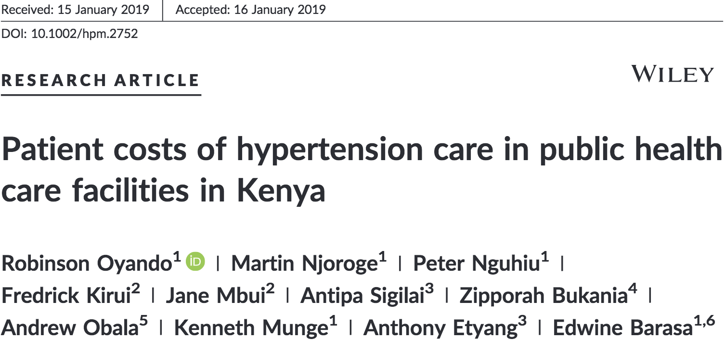
https://rdcu.be/bmKL7

Slide 12
Tweet us!
Funded by
KEMRI Internal Research Grant (IRG‐04) - AE
Wellcome Trust Research Training Fellowship (107527) –EB
Wellcome Trust International Master's Fellowship (214622) - RO
@HERU_KEMRI_WT
@KEMRI_Wellcome
@KEMRI_Kenya

